Slide 1



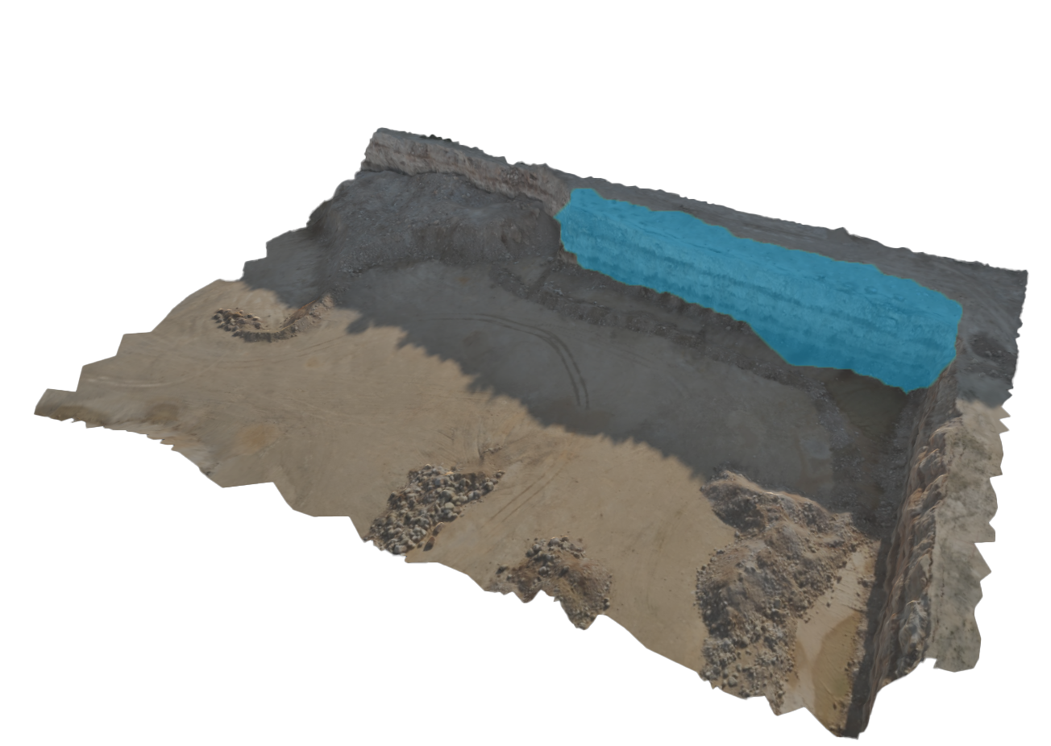
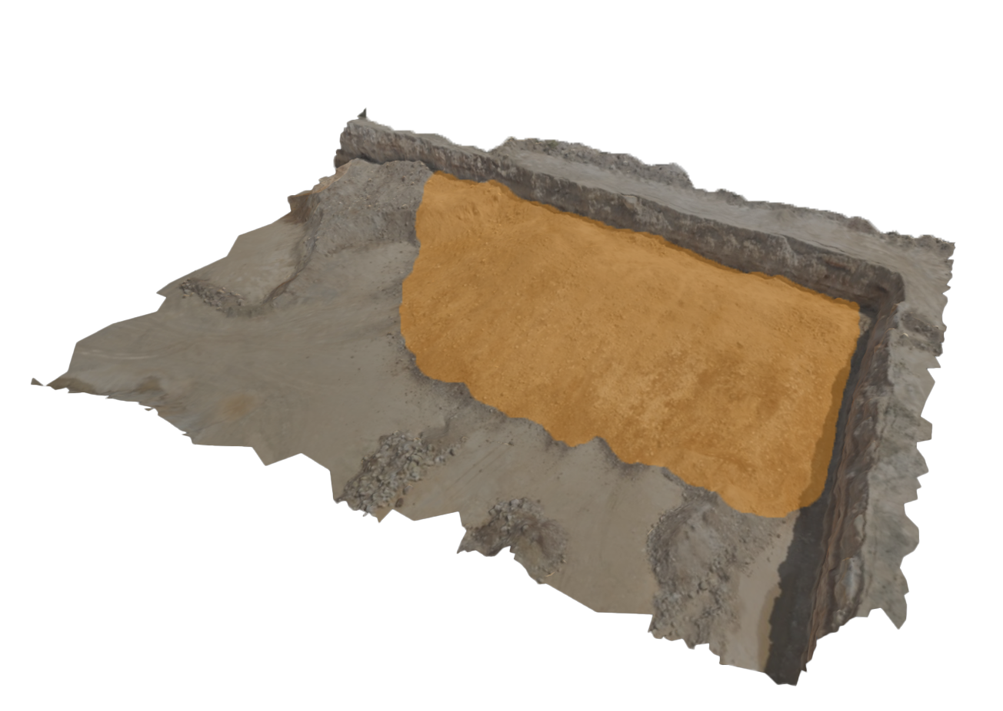
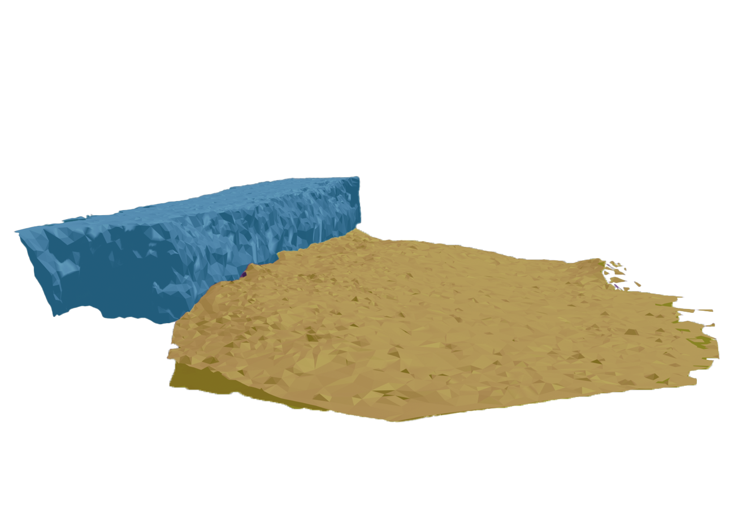
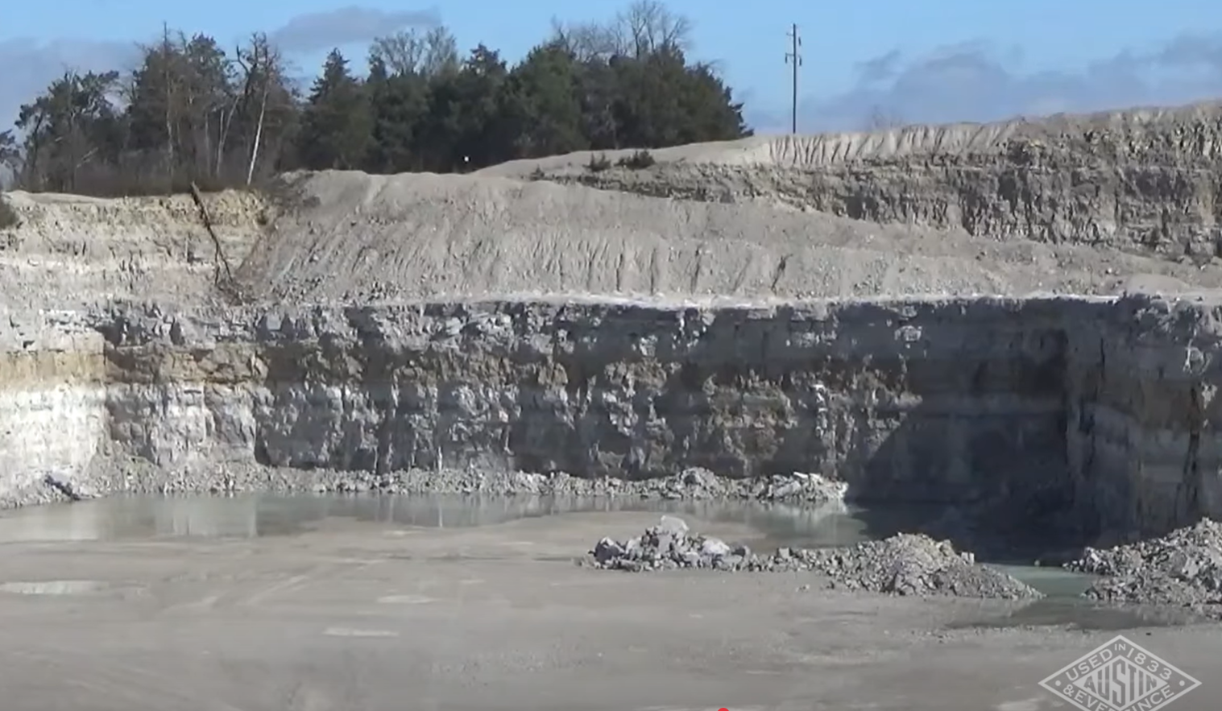
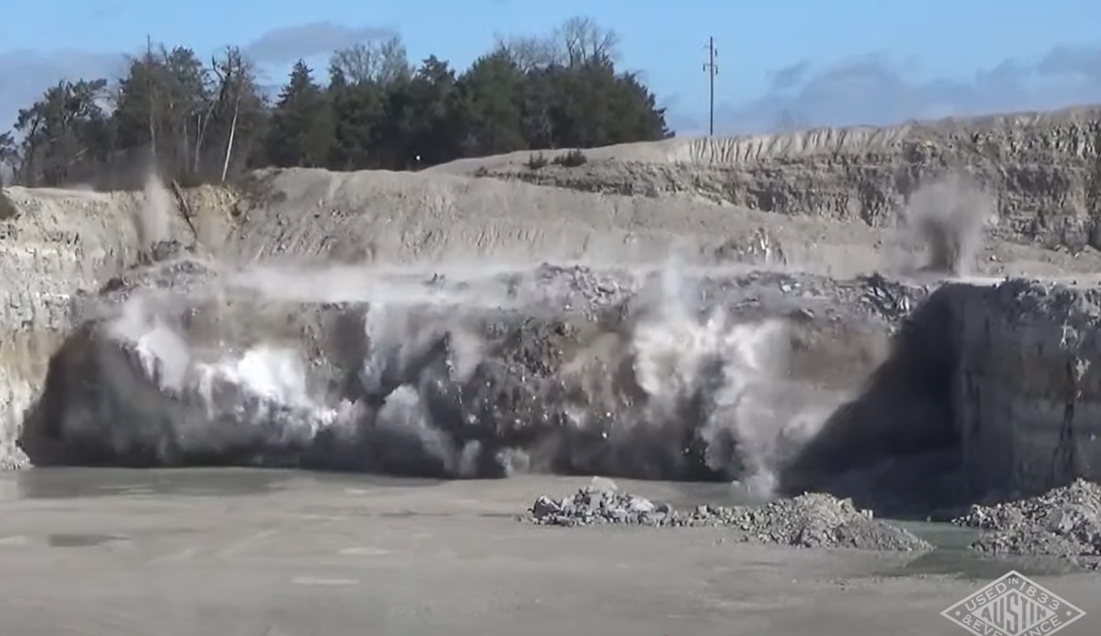
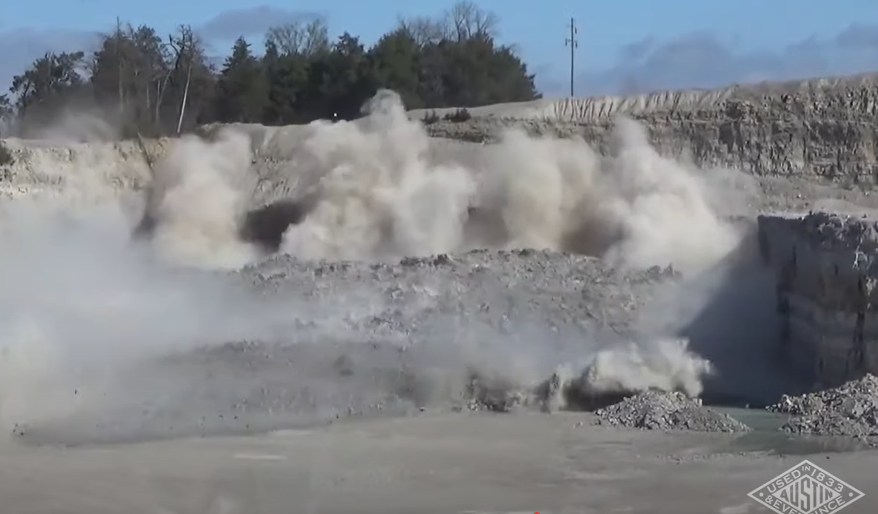
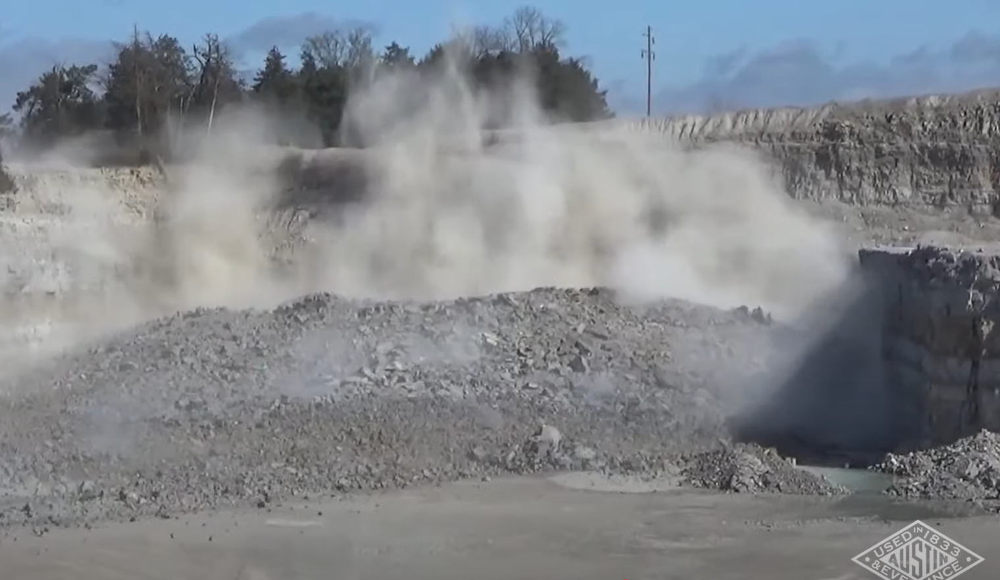
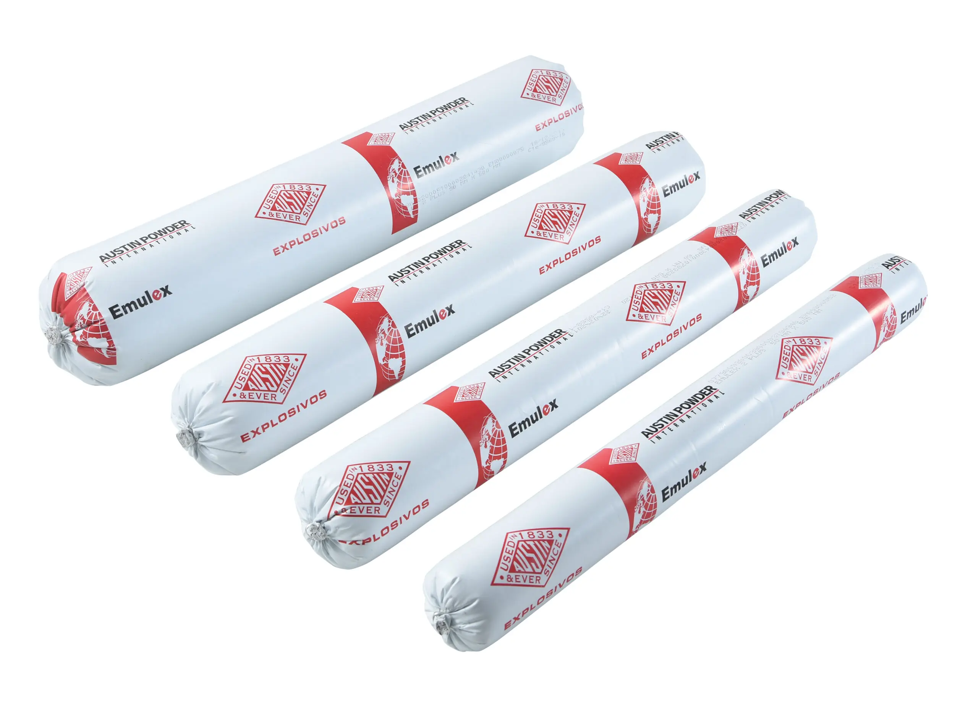
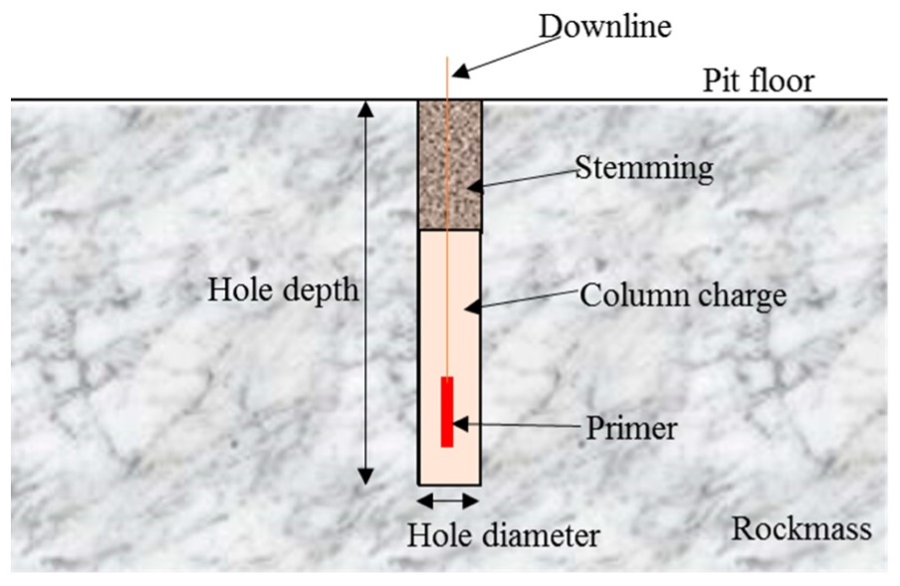
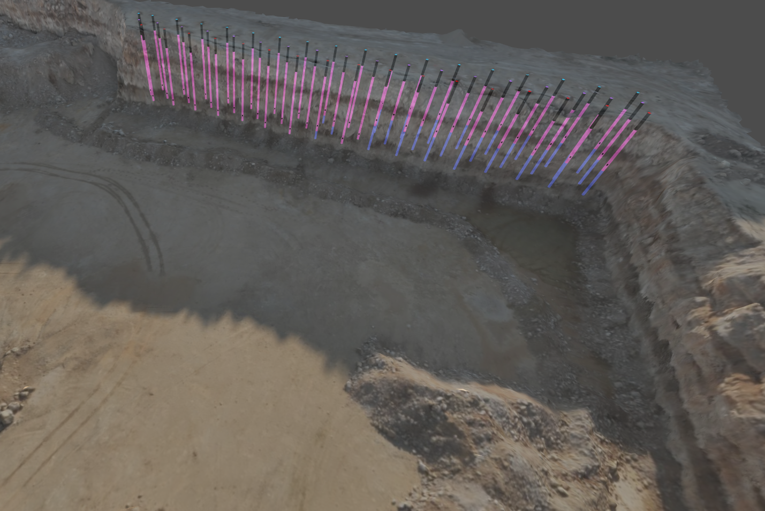
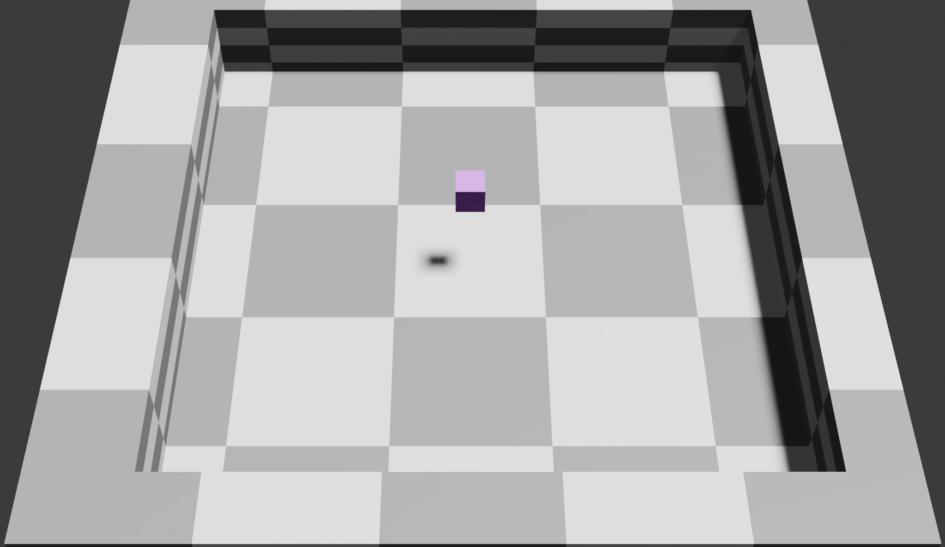
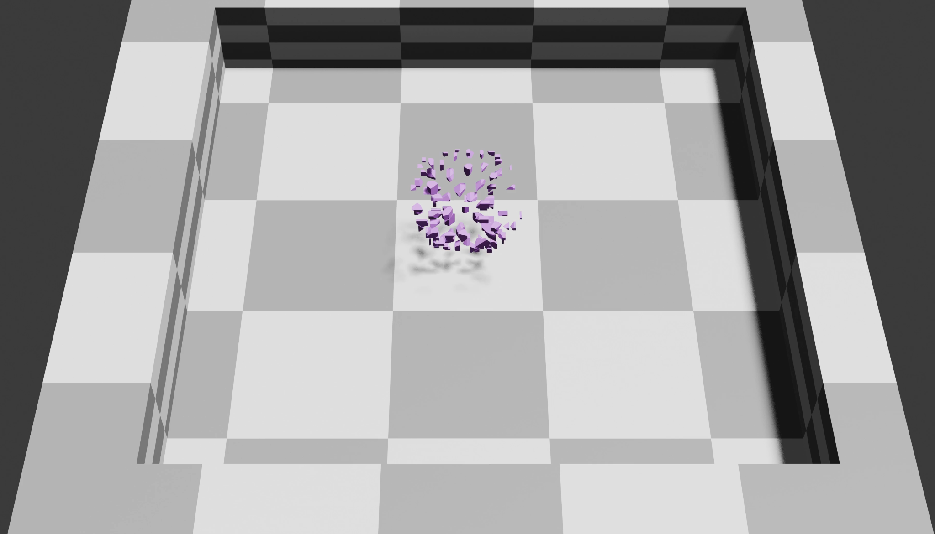
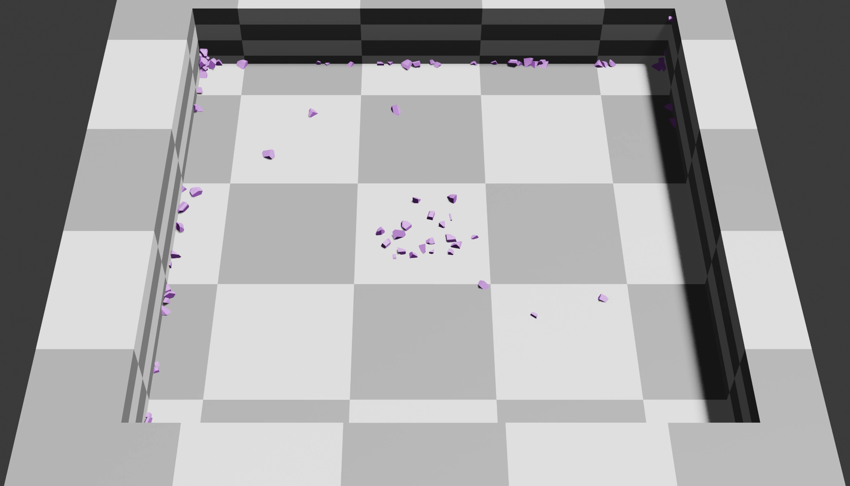
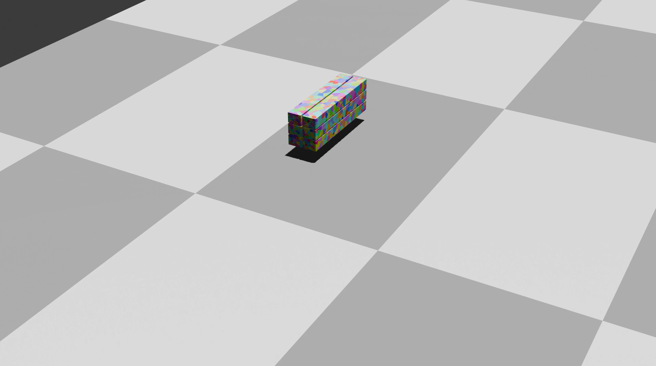
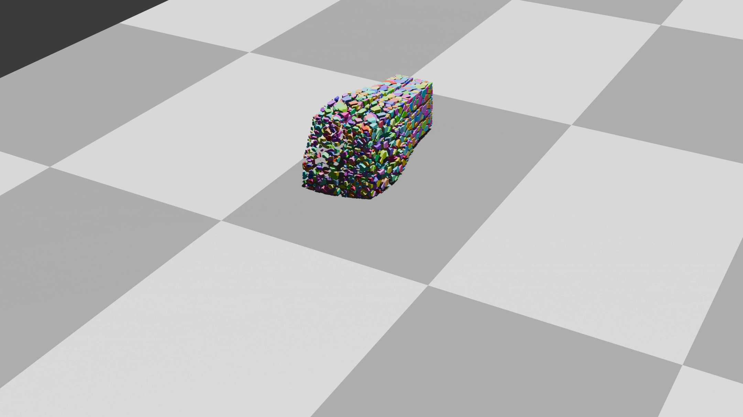
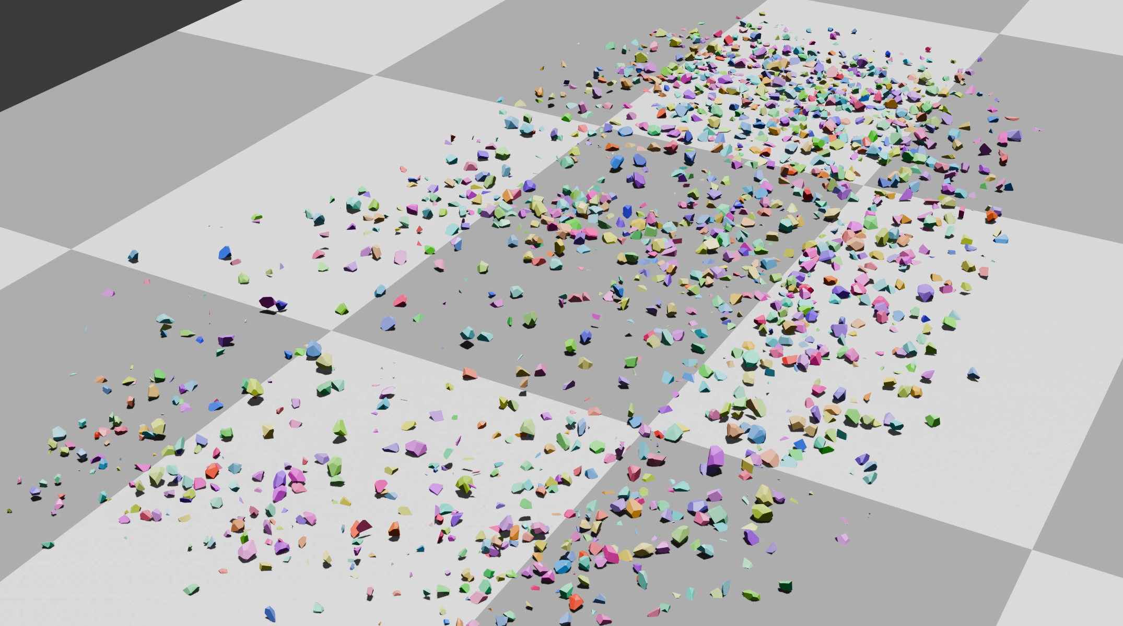
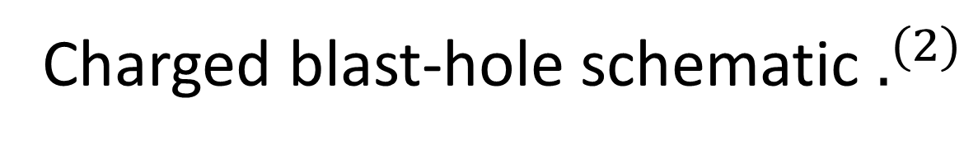
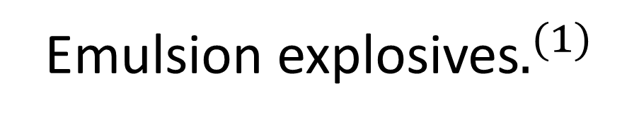


Muckpile Shape Prediction with a Physics-Informed AI Framework for Blast Modeling
Fei Zhang, Michael Gartley, Emmett Ientilucci
Introduction
III. Muckpile Formation in 3D Models
Blast control is vital to mining efficiency and safety. The muckpile—the rock pile left after a blast—shapes downstream loading and hauling performance. By fusing physics-based simulation with modern AI algorithms, our team aims to see seconds into the future: predicting the post-blast muckpile directly from the pre-blast terrain and explosive setup.
Pre-Blast Terrain
Post-Blast Terrain
What Happens When a Blast Unfolds
Blasting is an inherently complex process involving explosive detonation, rock fracturing, and gas–rock interactions.
Field Recording
Blast Process by Time Scale
(seconds)
Displacement Volume
1e-7
1e-6
1e-5
1e-4
0.001
0.01
0.1
1
10
Before: $2.55×{10}^{5} m^{3}$
t = 0s
Non-Ideal Detonation
Elastic Hole Expansion
After: $3.75×{10}^{5} m^{3}$
Nearfield Crushing
Example of displacement evaluation using 3D models derived from drone videos and Structure-from-Motion.
t = 1s
Equilibrium Pressure
IV. Physics–AI Co-Development Workflow
Radial Tensile Fracturing
Inputs
Blast configuration: pre-blast terrain, energy distribution, fragment geometry, rock and explosive properties, gravity…
t = 2s
…
Fragmentation
Physics-based Simulation (Teacher)
End-to-End Machine Learning Model (Student)
MLP
Feature-grouped MLP
LSTM
Transformer
PINN
…
Burden Acceleration
Numerical Models
Finite Element Method (FEM) Computational Fluid Dynamics (CFD)
Discrete Element Method (DEM)
Generate & Train
Muckpile Formation
t = ns
Mine Scale Vibrations
Simulation Engines
Blender (Bullet), MuSEN, …
Outputs
Fragment trajectories and final muckpile shape (t = N s)
t = 0s
V. Prototype Experiments
Emulsion explosives$.^{(1)}$
Charged blast-hole schematic $.^{(2)}$
t = 1s
t = ns
…
Experiment #1: Single-point blast test. A cube model (100 shards) subjected to a single impulsive force field, simulating a localized explosion.
…
Example of a field blast setup with multiple charged boreholes.
Experiment #2: Sequential-blast test. A bench-shaped model (2000 shards) subjected to two sequential impulsive force fields, simulating multi-point detonation.
Figure credits: (1) Austin Powder ; (2) O-Pitblast .
For more information, contact Fei Zhang at fzhcis@rit.edu, or visit https://github.com/fz-rit/blast-simulation-showcase

